Slide 1

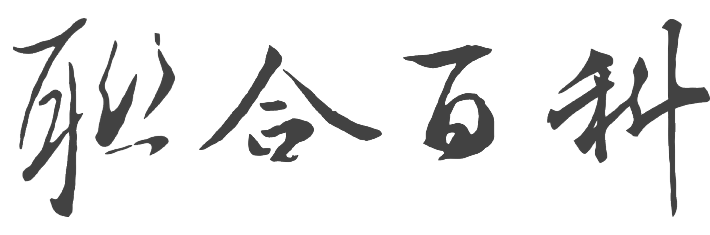

Introduction
United Digital Publications Ltd., Co.

Slide 2



Unearthing the Treasures
in Chinese and Asian Studies
UDP’s logo reflects its vision: the blue ocean symbolizes Taiwan’s open and inclusive spirit, while the red pearl represents the refined treasures of Chinese scholarship and Asian studies. Since 1992, UDP has built a Taiwan-based brand committed to high-quality humanities and social sciences databases, driven by continuous innovation — including AI-powered semantic search, multilingual translation and search and image-to-image search, launched from 2023 to 2026 — redefining the digital research experience for Chinese-language scholars.
1,200+ Libraries
60+ Languages
4.5 Billion Characters
Universities, libraries, institutions
Multilingual Databases (EN/RU/DE/ZH)
Full-text-full-images platform
Notes:
公司標誌上的「藍色海洋」象徵「臺灣」海納百川、開闊包容又柔軟的海國性格；「聯合百科」選用蘊含中國文化的書法字體；其上的「紅珠」則象徵「漢學研究之珠」 。
For the story behind our logo, the “blue sea” signifies Taiwan’s characters as a maritime country — broad-minded, tolerant and flexible. “聯合百科” presented in the form of calligraphy which symbolizes our mission to promote Chinese culture. The red pearl imbedded in “udp” stands for our high-quality archives of Asian studies — the pearl of sinology.

Slide 3
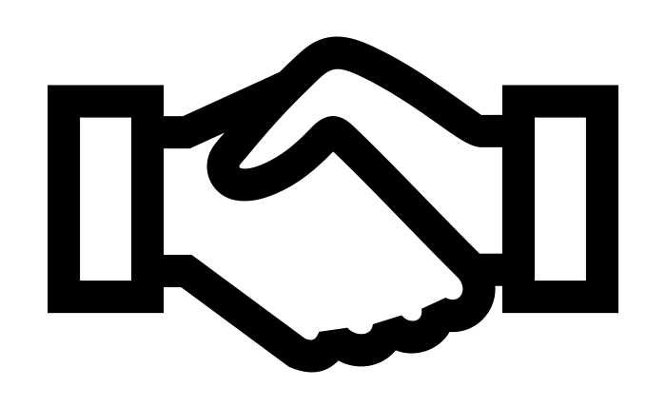
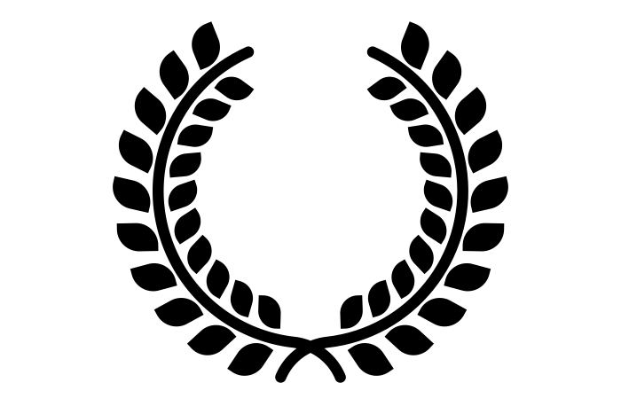

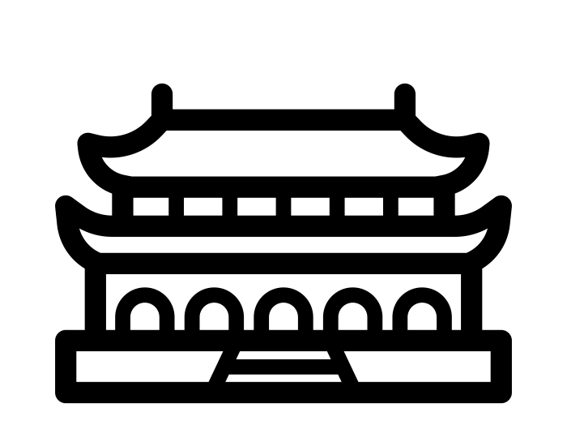
Milestones
Explore the long river of culture
2009
2011
2015－2019
2020－present
Cooperated with Sinica
Government grants
TAC platform launched
Authorized by National Palace Museum
UDP collaborated with Academia Sinica to build up the sole full-text and full-image databases of their kind.
UDP has been awarded two competitive grants from the Taiwanese government in recognition of its innovative services.
The platform integrates 12 crucial databases, 4.5 billion characters, and 370,000 dissertations.
Produced “National Palace Museum Journals Digital Archive.

Slide 4






Awards
Recipient of national-level awards and government grants;
repeatedly shortlisted for major publication awards.

Slide 5
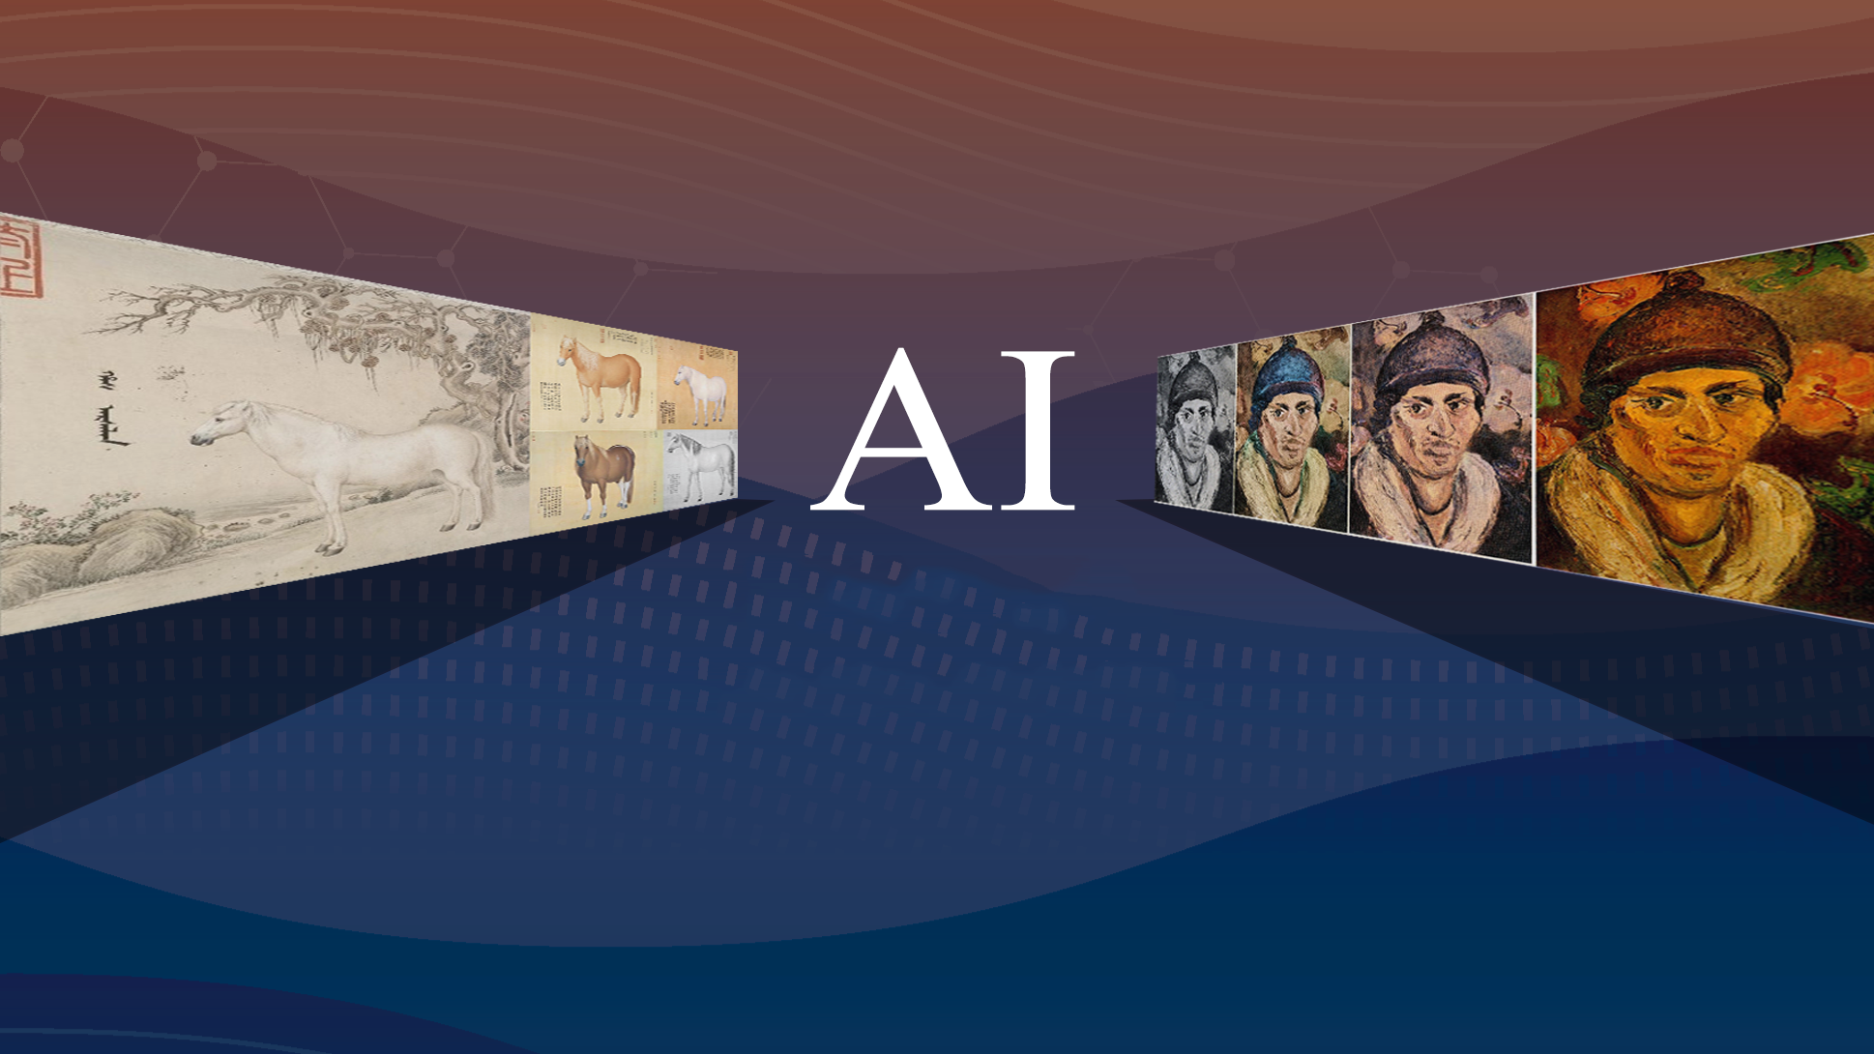
Humanities, Arts, Social Sciences
Opens New Research Horizons
Beyond Search, Toward Discovery

Slide 6

Grounded in Asia,
Reframing the Non-Western Knowledge Landscape
The Classics of Chinese Scholarship and Asian Studies

Slide 7
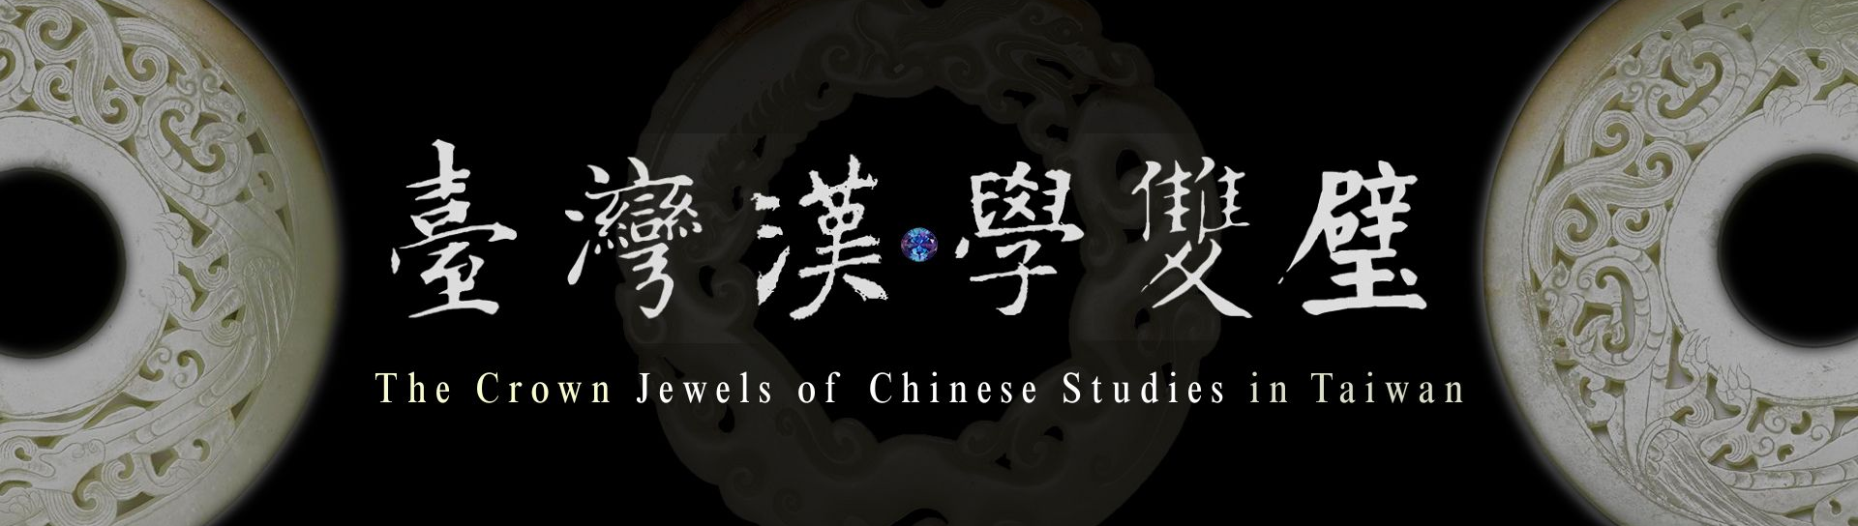
Taiwan’s World-Class National Treasures
National Palace Museum Journals
Digital Archive
Sinica Sinoweb
(Academia Sinica Journals in Humanities)

Slide 8


AI-Powered Database Platform
Multilingual Search & Full-Text Translation
Semantic Search
Image-to-Image Search
Automatic Colorization
Cross-Cultural Content & Perspectives
Precise Full-Text String Search

Slide 9
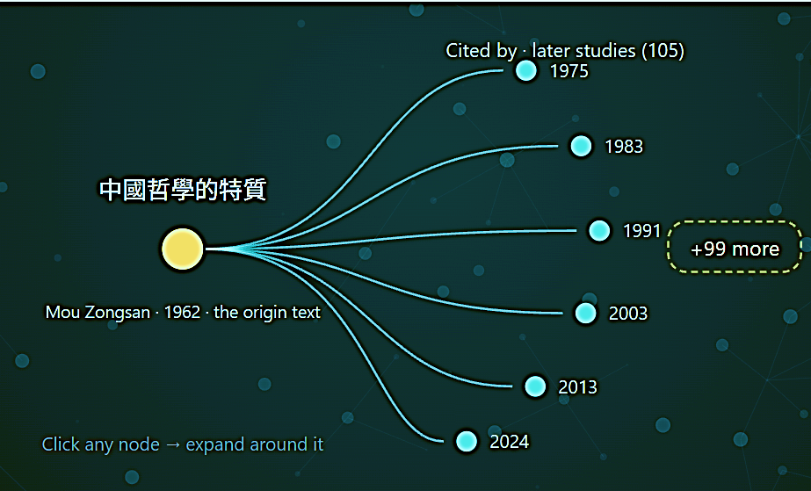
Lumen—AI-Powered Discovery
(Integrated with Taiwan Academic Classics)
Century-Spanning Journals × Chinese & Asian Studies × Verifiable AI Search
Multilingual Search · Text Translation · Connecting Diverse Knowledge Pathways
《 4 Key Features》
● Citation Networks
● Multilingual Inquiry
● Historical Depth
● Extended Exploration

Slide 10
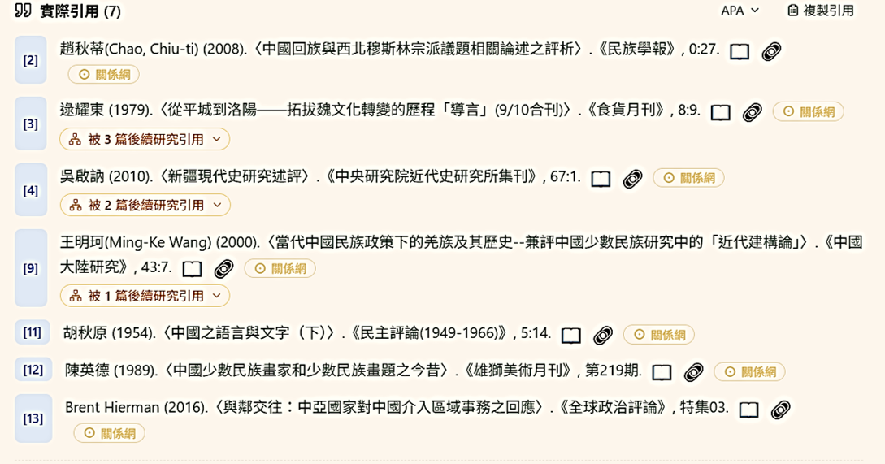
Cited References from the 1950s to the Present

Slide 11
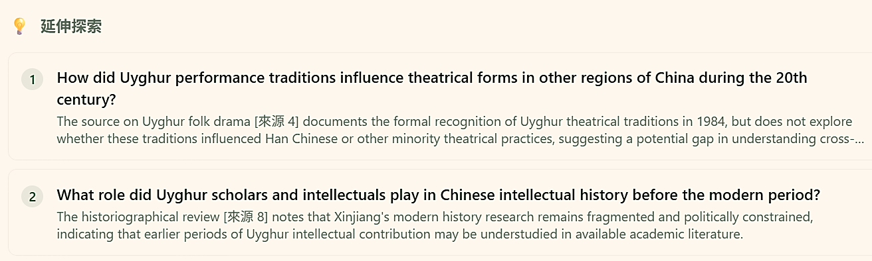
Uncover Hidden Connections in Knowledge
Extended Exploration

Slide 12
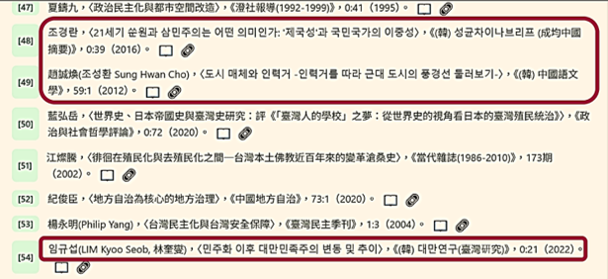
Connecting Knowledge Pathways Across Languages

Slide 13
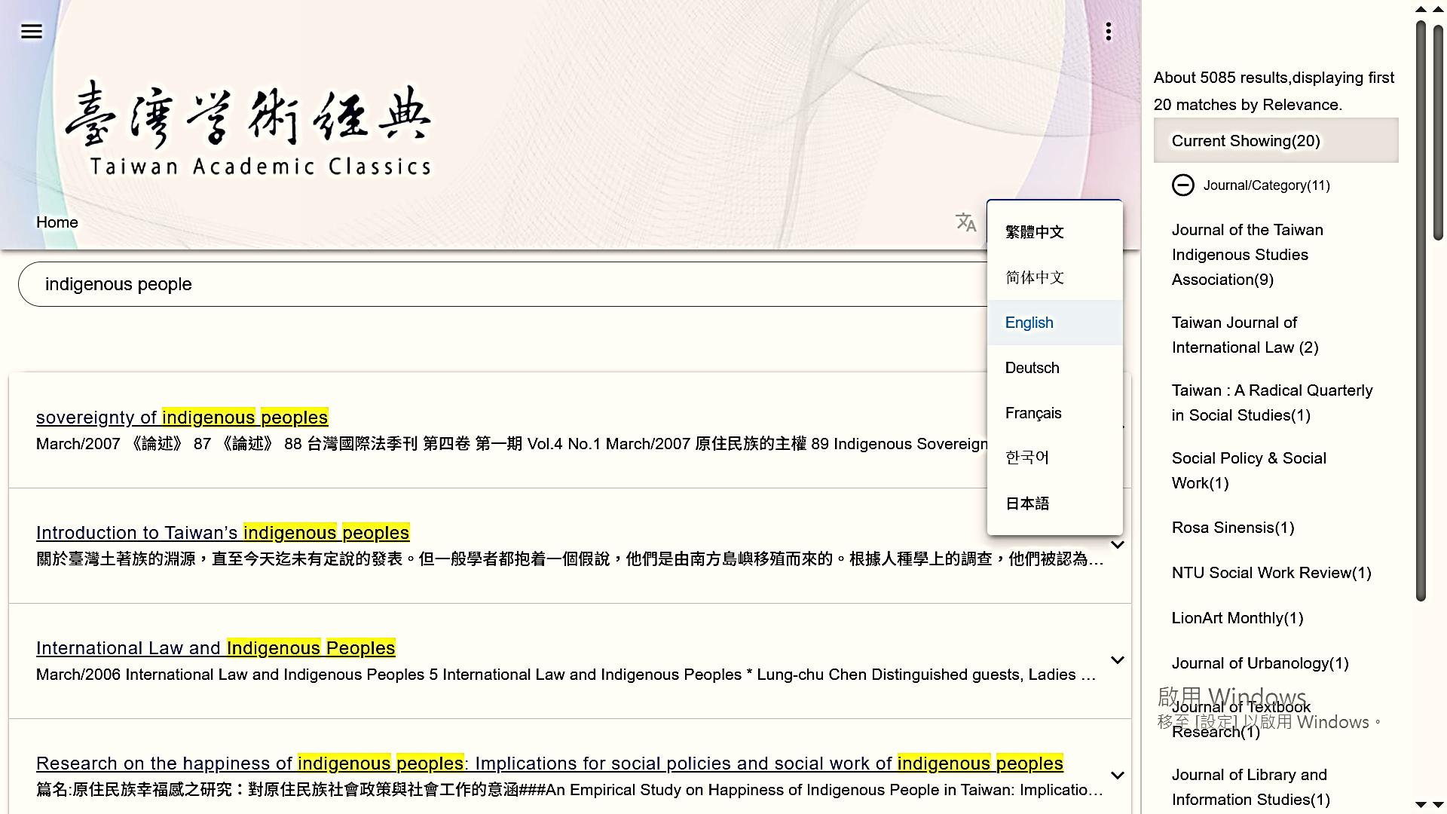
Multilingual Metadata Search

Slide 14
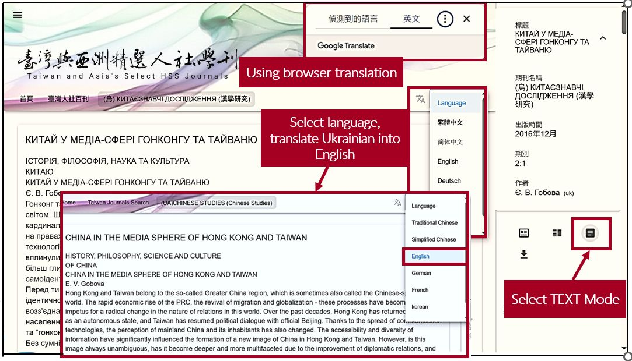

Slide 15






Taiwanese HSS
Chinese Classics
Global Think Tank
Notes:
修改背景

Slide 16


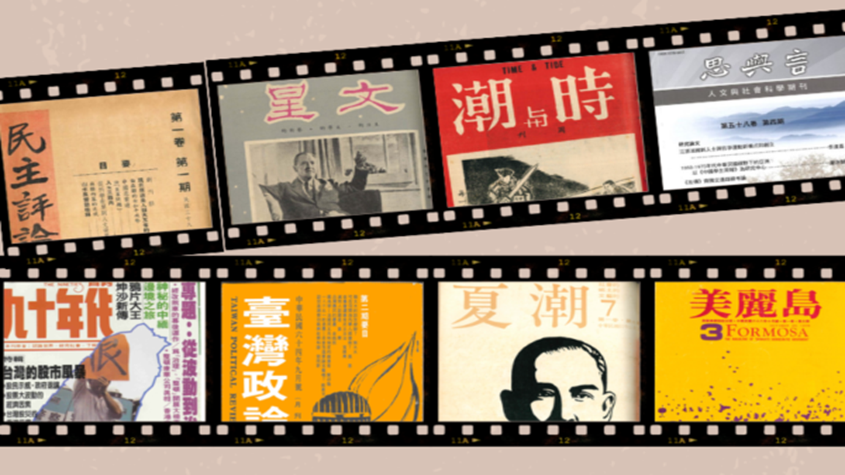


Taiwanese HSS
This series centers on Taiwan’s rich scholarship of humanities and social sciences , showcasing the open perspectives of Taiwanese scholars and the vibrant achievements of its academic community.
人文臺灣
臺灣，擁有五千年中華文化潤澤的人文底蘊，又地處亞太平洋區塊的樞紐位置，早已是「國際漢學」、「當代中國研究」社群中關鍵的一環；臺灣多元社會、海納百川的學術氛圍，更為世界各國探究華人文化與中國社會不可或缺的通路；取道臺灣，就能逕登漢學堂奧。本系列以臺灣最動人的人文學為核心，呈現臺灣學人的開放觀點，以及優秀學術社群的豐美成果。
Notes:
人文台灣

Slide 17
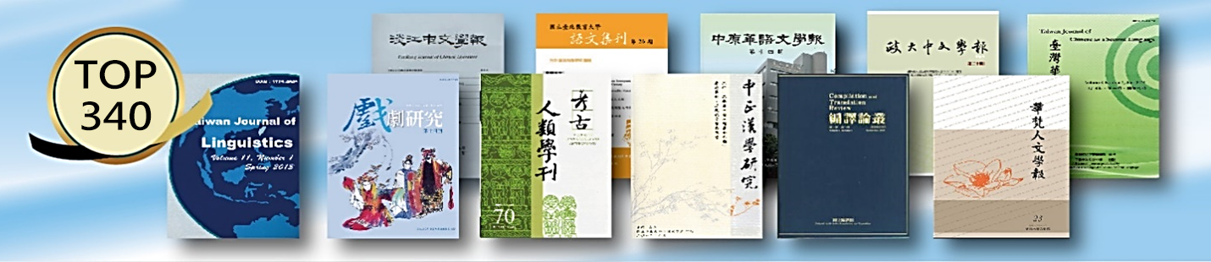

Taiwan and Asia’s Select HSS Journals
Multilingual Search × One-Click Translation × Perpetual Access
• 400 journals from 20 countries — 350 from Taiwan + 50 from Asia & Europe
• Asian perspectives, local voices — complementing Western narratives
• Beyond mainstream platforms — local scholarship missed by major databases

Slide 18
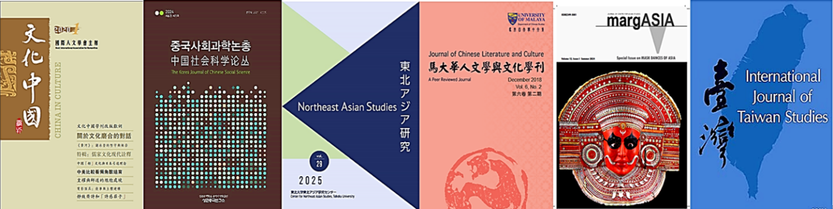
Curated International Series:
Asian Studies • International Sinology • AI & Digital Humanities
• Chinese and Taiwanese Studies from Japanese and Korean Perspectives
• Cultural Identity in Southeast Asian Chinese Communities
• Postcolonial Culture and Contemporary Social Change in South Asia
• How Asian Scholars Write Their Own Histories and Societies

Slide 19
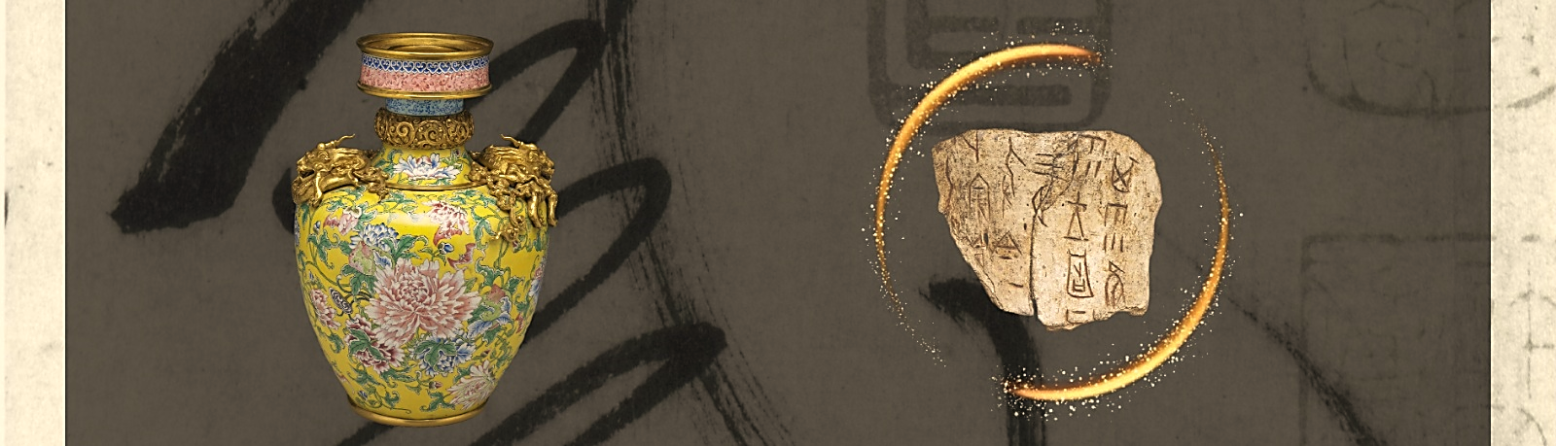
Sincia Sinoweb
(Academia Sinica’s journals in humanities)
1928–Present | Complete Coverage | A Century of Taiwan Sinology, Rediscovered with AI
• Bulletin of the Institute
of History and Philology
• Bulletin of the Institute
of Modern History
• Research on Women in
Modern Chinese History
• Oral History Journal
• Bulletin of the Institute of
Chinese Literature and Philosophy
• Taiwan Journal of Anthropology
• Taiwan Historical Research
• Chinese Studies
• Newsletter for Modern Chinese
History
• Shih-Huo Monthly
• Thought and Words
• Legein Semi-Annual Journal
• Legein Monthly
• Journal of Chinese Ritual,
Theatre and Folklore

Slide 20
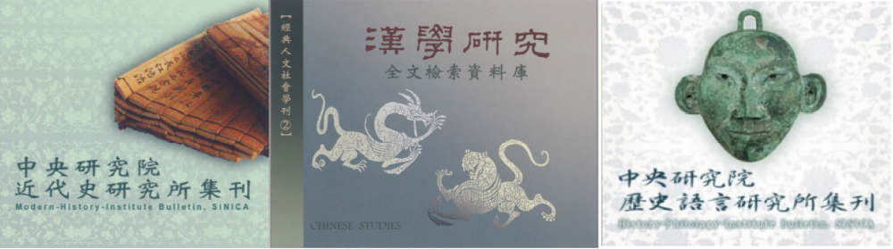
Sincia Sinoweb
(Academia Sinica’s journals in humanities)
• A Century of Taiwan Sinology, Rediscovered with AI
• Multilingual Search × Translation — for Non-Chinese Readers
• Trace Knowledge Across Journals, Decades & Cultures
• 30% Exclusive Rare Content, BIHP Full-Text Reconstruction

Slide 21
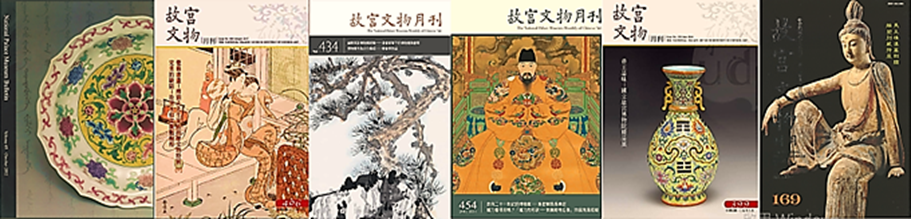
National Palace Museum Journals Archive
1966–Present | 10,000 Articles | 350,000 Images | 18,000 Object Entries | 652 Videos
AI Connects Knowledge Across Time
●NPM Monthly of Chinese Art
●NPM Research Quarterly
●NPM Bulletin
● NPM Quarterly
＊NPM Antiques Lexicon
＊NPM Video Library
＊Full-Text Search
＊ Image-to-Image Search
＊AI Colorization
＊ Multilingual Search
& Translation
(＊ Exclusive)

Slide 22
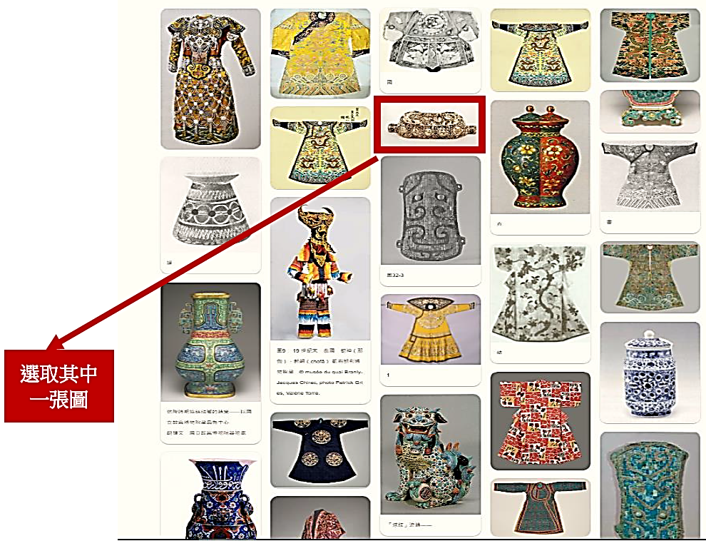
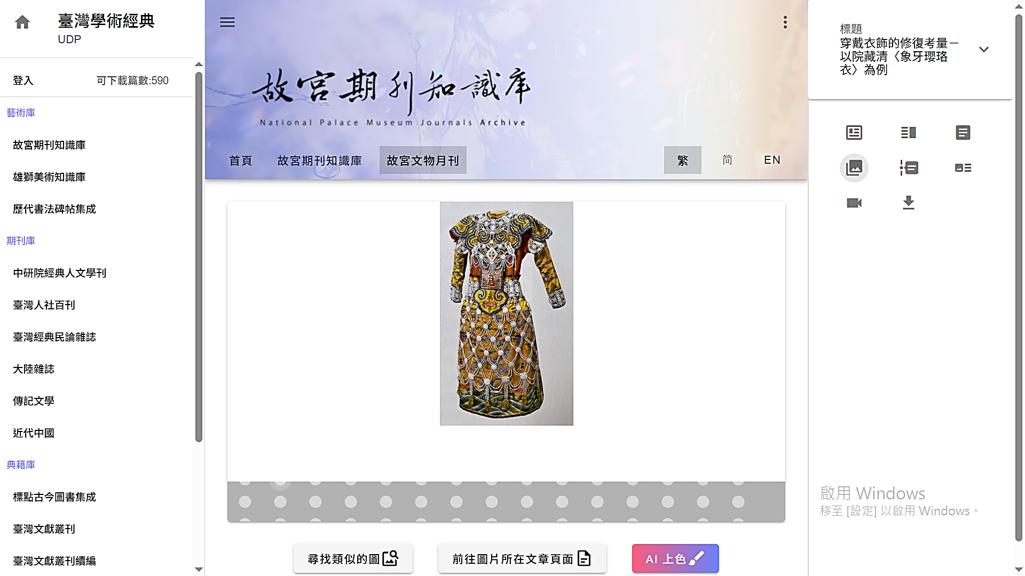
Image Search
Select one
Search Results:
Objects resembling yingluo span jewelry, clothing, vessels, animals, and doll costumes, offering cross-domain connections and greatly expanding researchers’ imaginative scope.

Slide 23
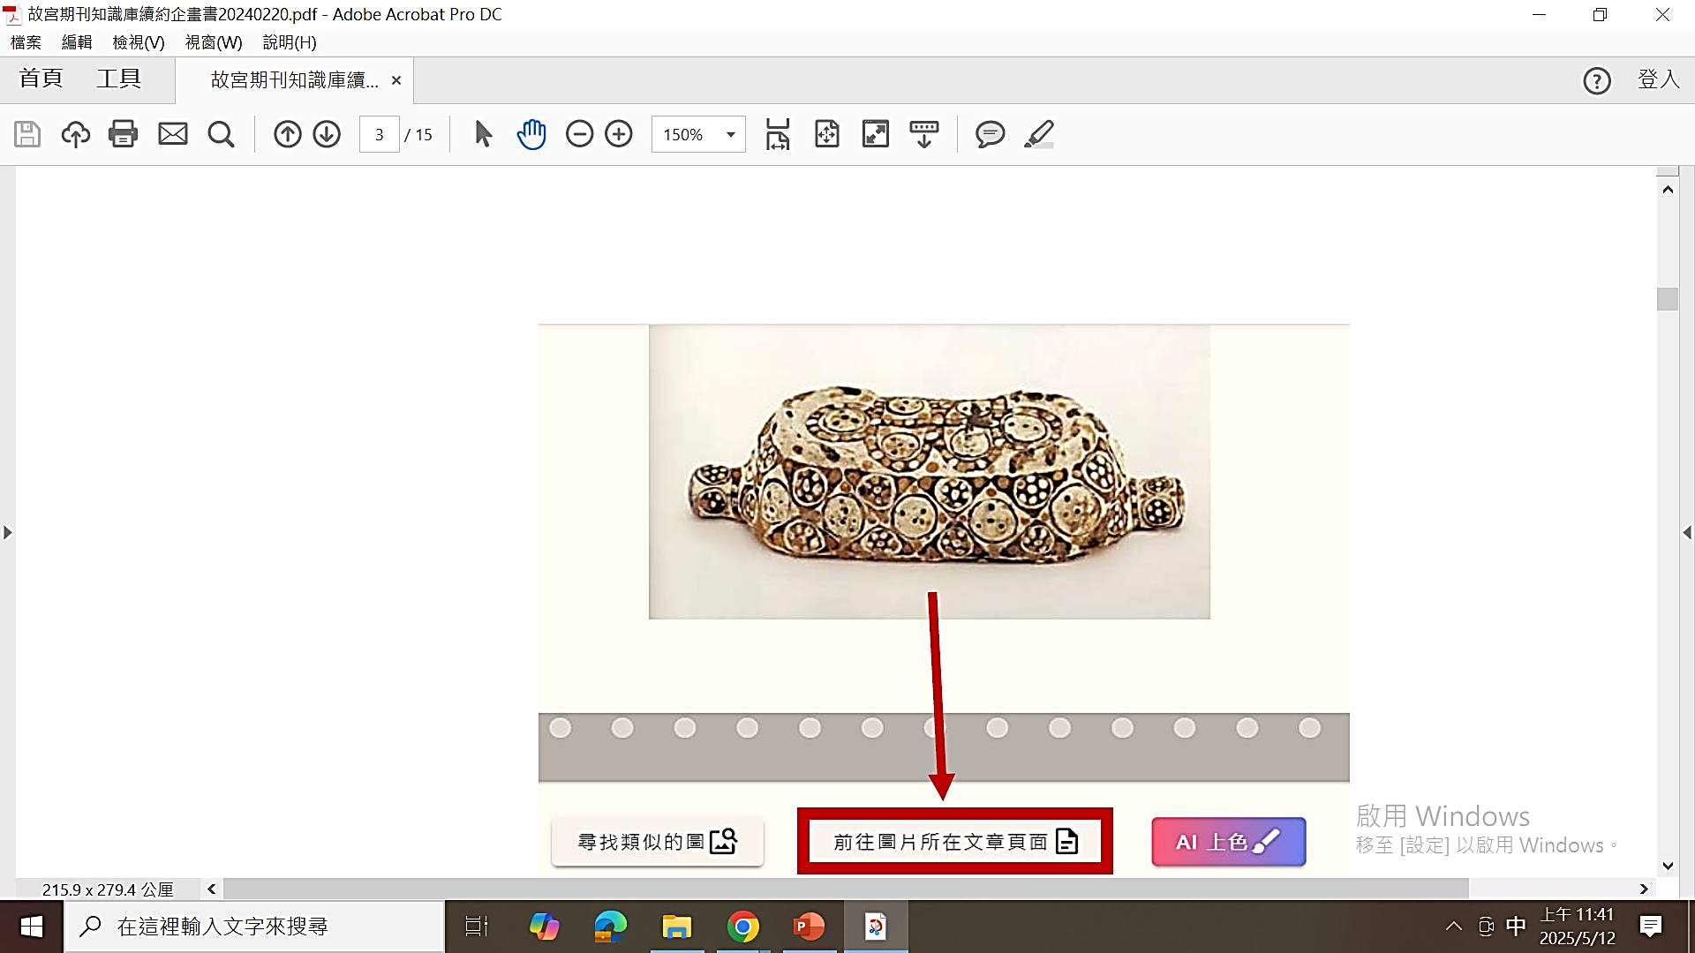
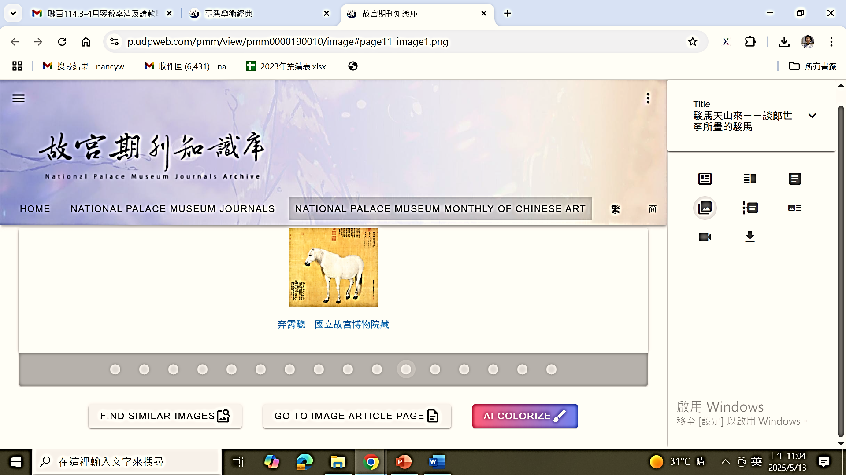

Slide 24
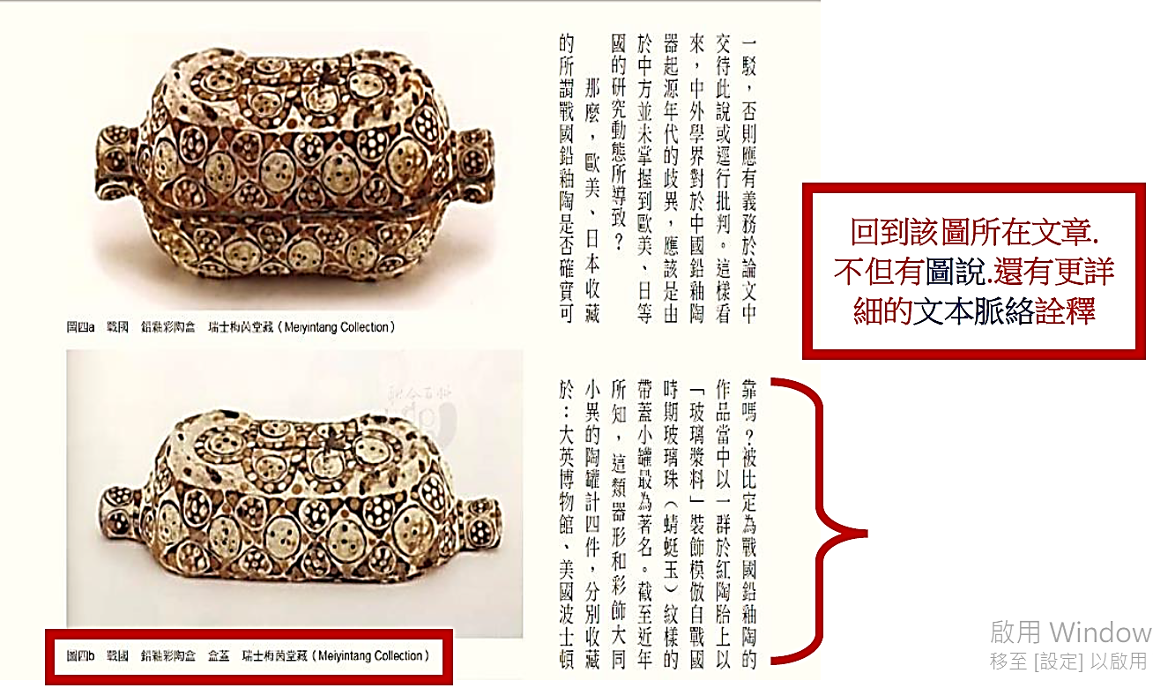

Return to the image’s article for its caption and fuller context.

Slide 25
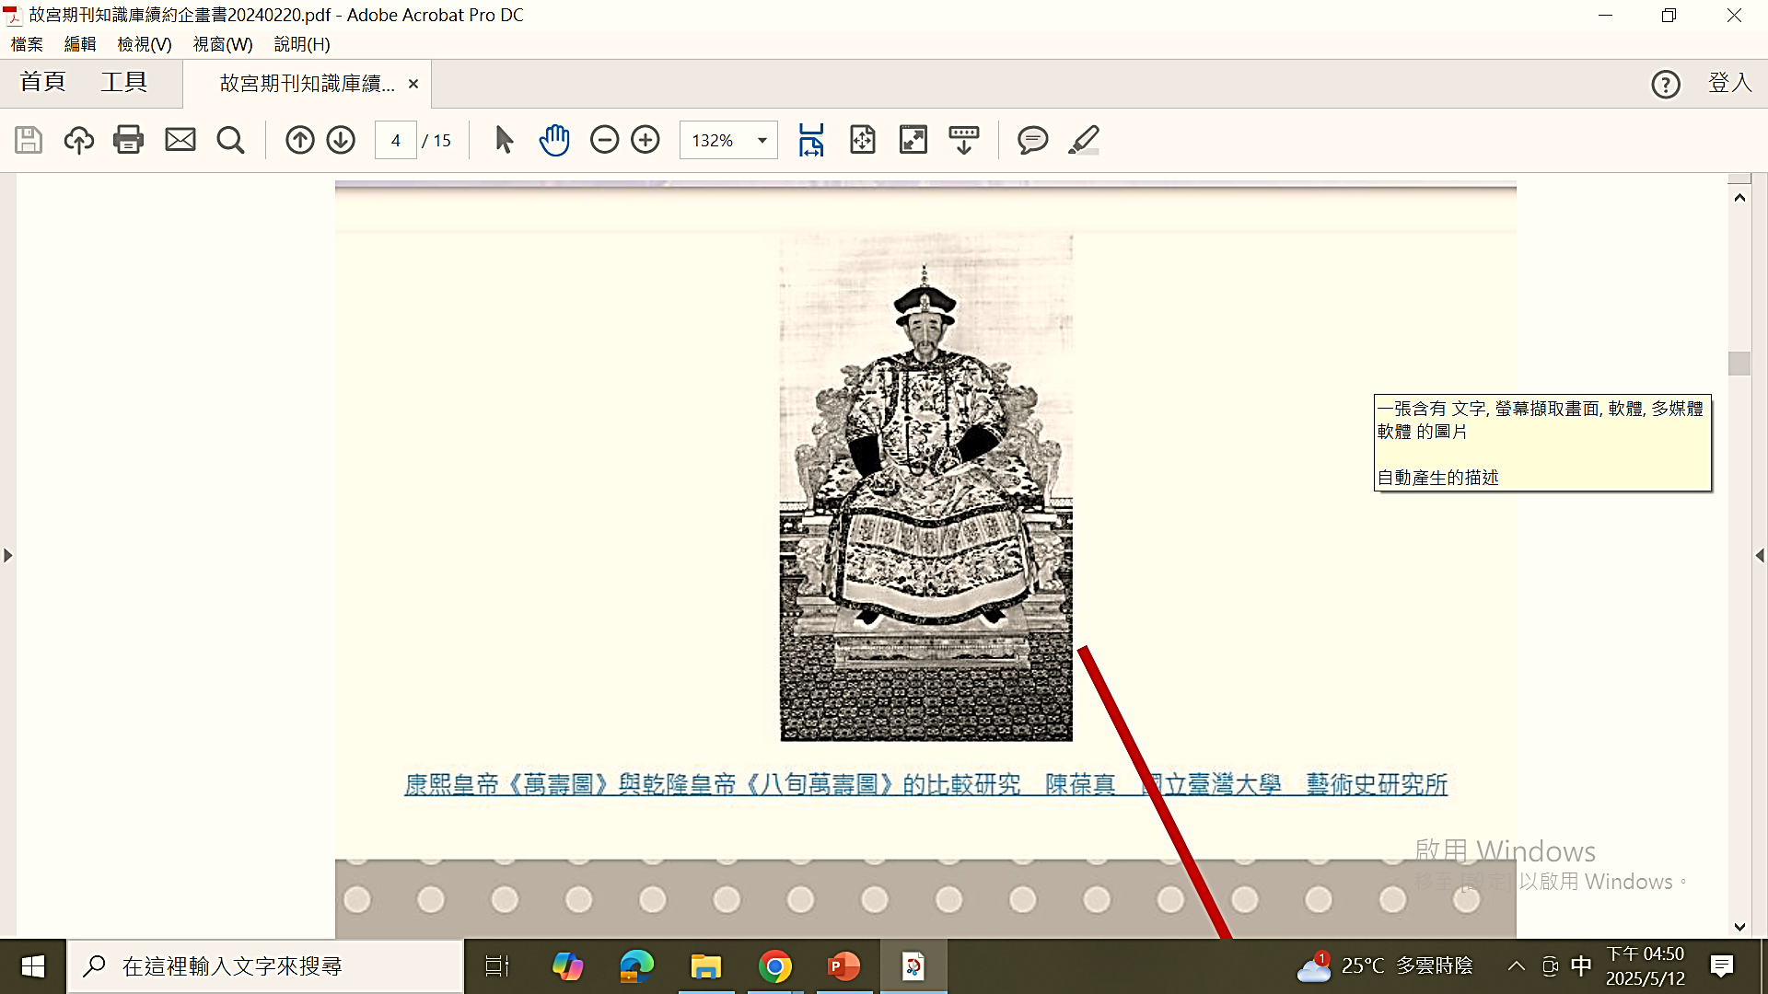
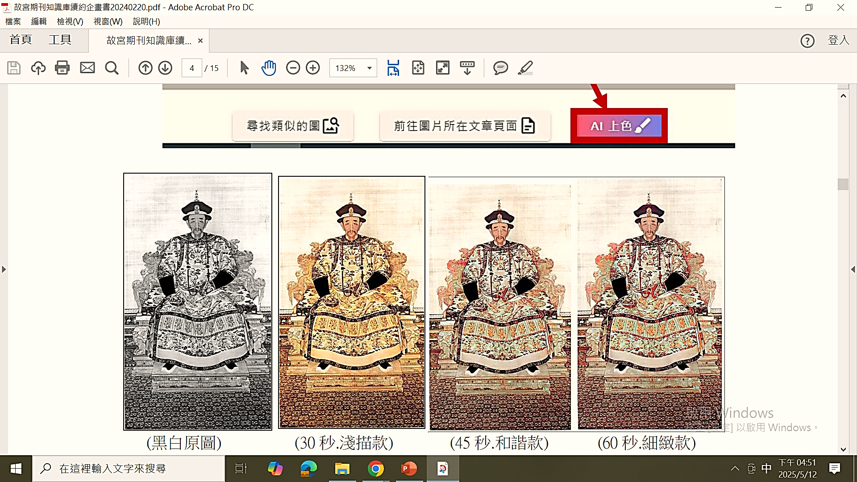
AI Colorization
Original Image 30s 45s 60s after Colorization

Slide 26
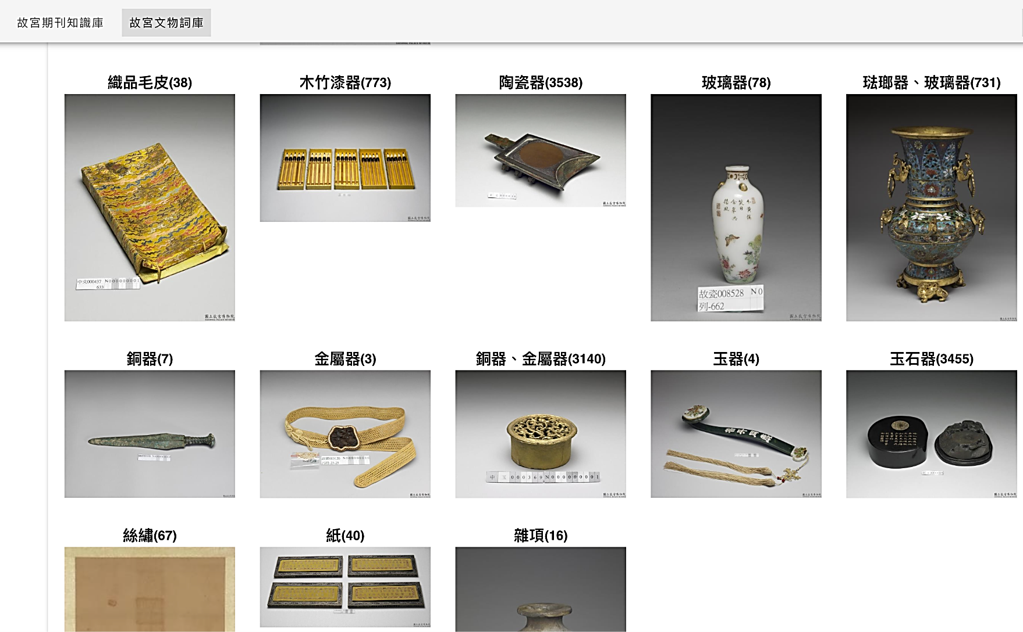
NPM Antiques Lexicon

Slide 27
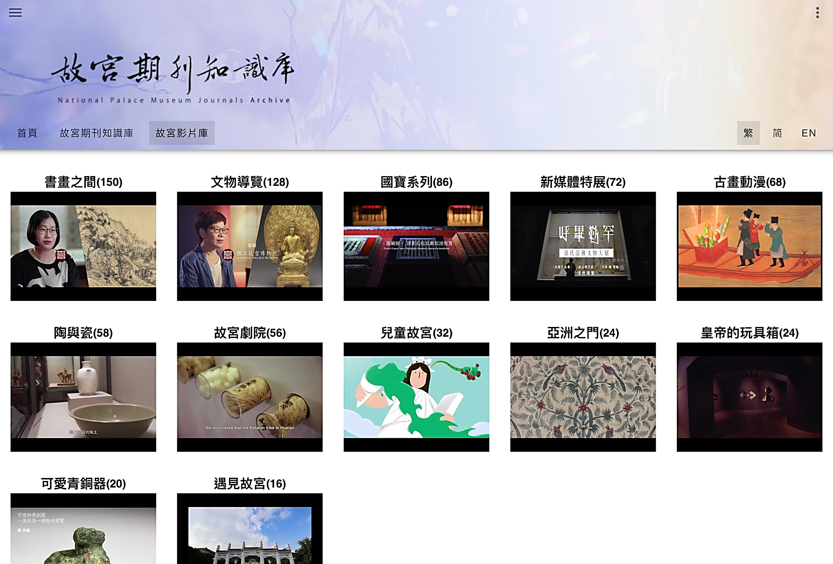
NPM Video Library - Youtube
12 Series
652 Videos
Notes:
影音圖像的方式
專家學者，用專家的口吻說出輕鬆有趣的故事。
深入淺出的方式引領有興趣的民眾或研究人員有更深一層的瞭解。

Slide 28
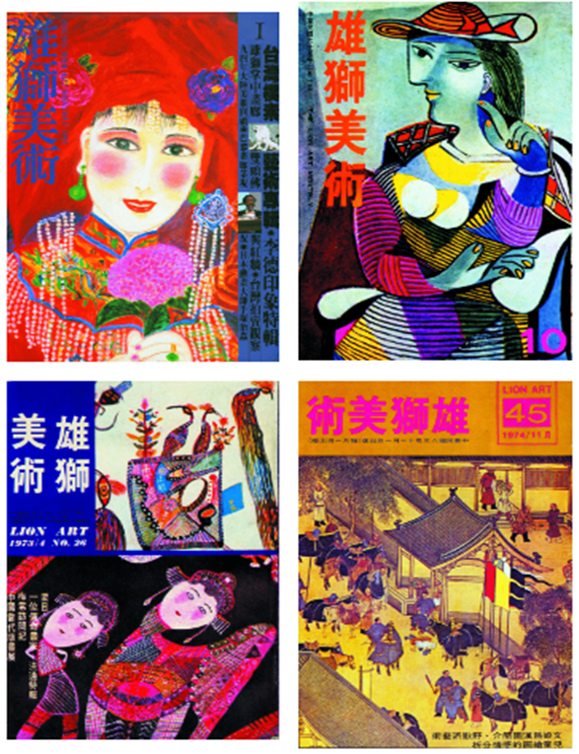
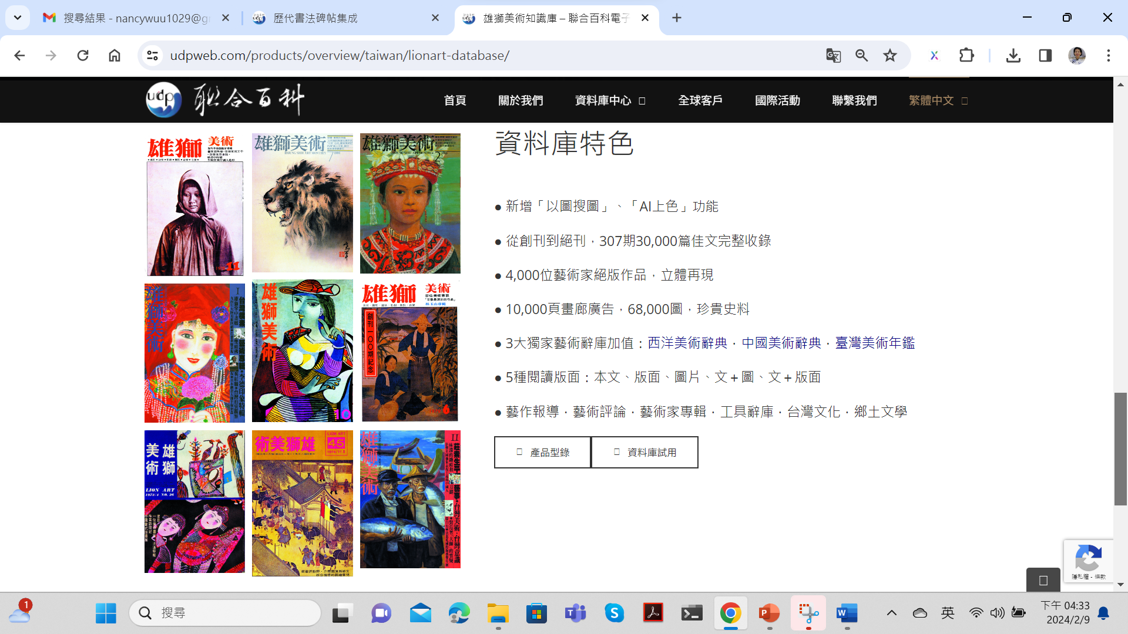
Lionart Digital Archive
1971–1996 | 33,000 Articles | 68,000 Illustrations | 12,000 Prints | 10,000 Gallery Ads
East Meets West, AI Reimagines Art
●Lionart Monthly ●Chinese Art Dictory ＊ AI Colorization
●Taiwan Art Dictory ● Western Art Dic tory ＊ Image-to-Image Search

Slide 29
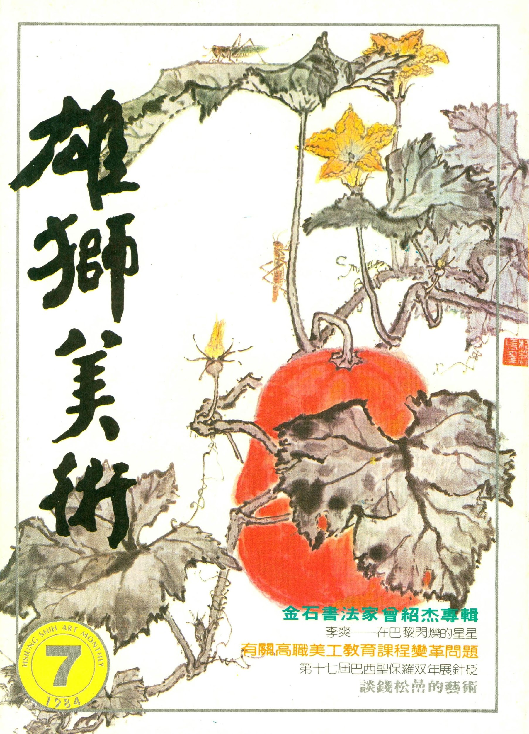
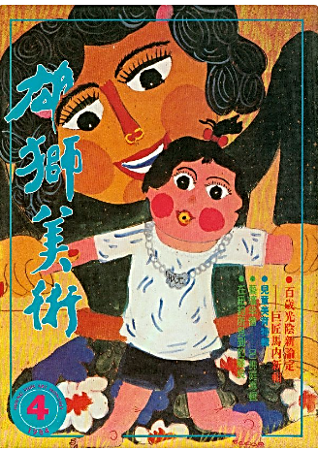
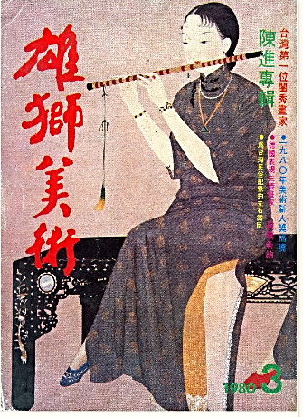
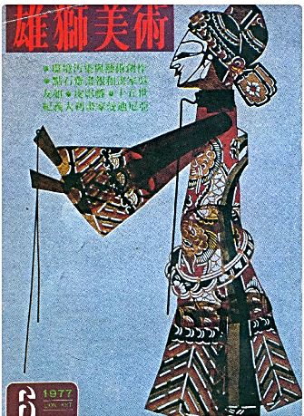
AI Search × Image Search & Colorization × Multilingual Access
“Pioneering Taiwanese Artists” Collection preserving exclusive historical records of masters
Art Meets Humanistic Concern
Renowned literary and artistic figures contributed as authors
Emerging Talent Awards spotlight rising artists
Notes:
Banner視覺更新（跟我要檔案）
數字4,000（可檢查整份簡報內的數字，統一加上千分號）

Slide 30
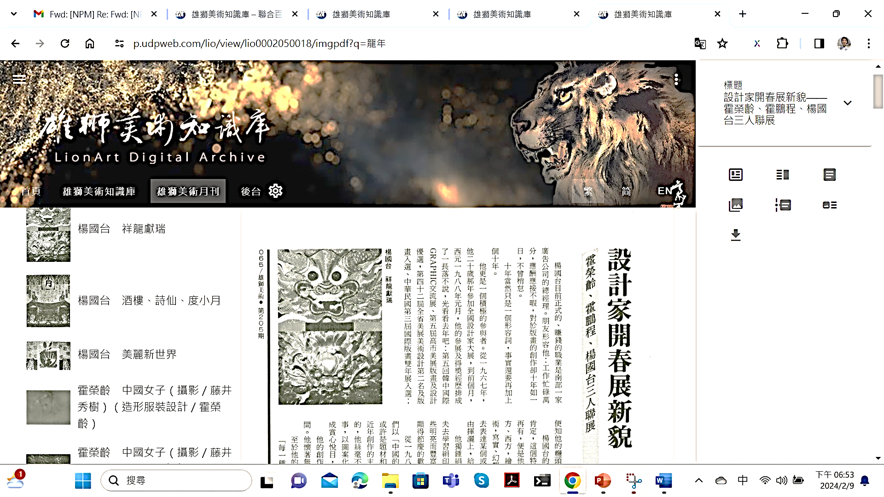

7 reading modes

Slide 31
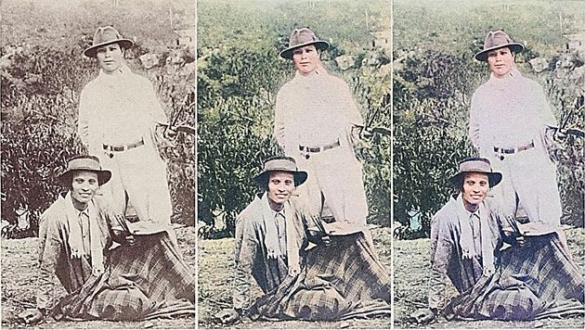
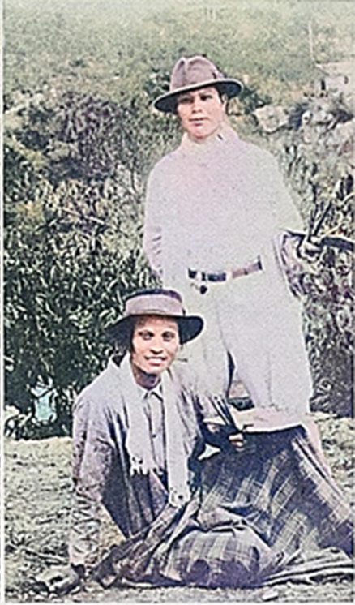

Original B&W Image 30s After Colorization 60s After Colorization
AI Colorization

Slide 32
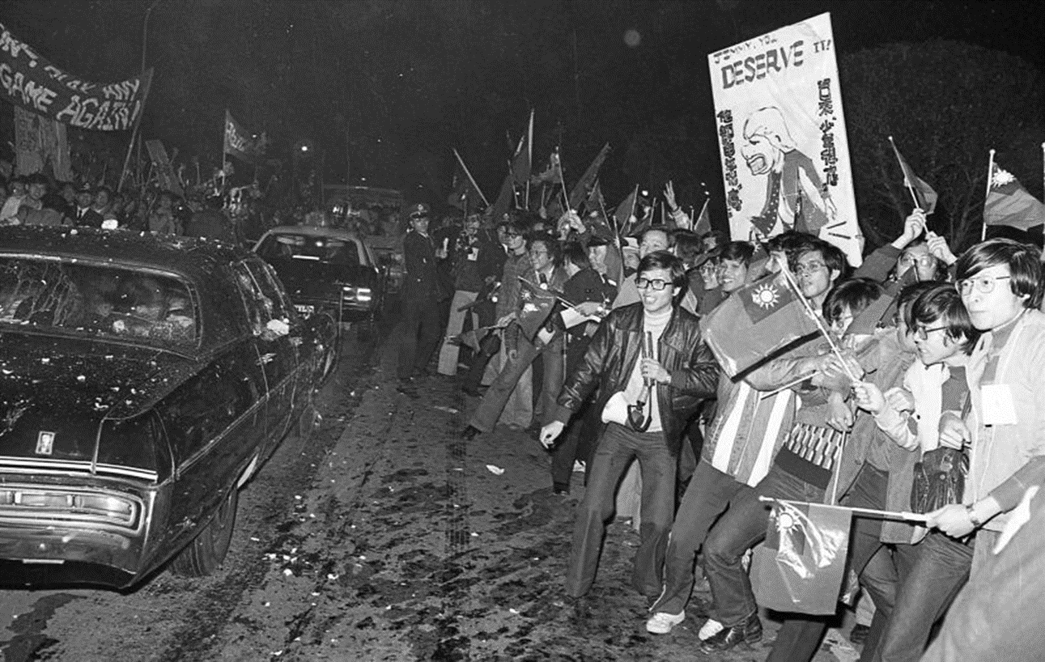
Taiwan Epochal Democracy Magazines (1949–1992 launched )
Witness Voices of Dissent
under Authoritarian Rule in Taiwan and Hong Kong
•Tracing the transition from Chiang-era
authoritarianism to democracy, across generations
•Landmark public forums shaping opinion in different
historical moments
• Contributions from leading figures in classical studies
and social sciences
• Exclusive, defunct classic titles that helped awaken
modern Taiwan

Slide 33
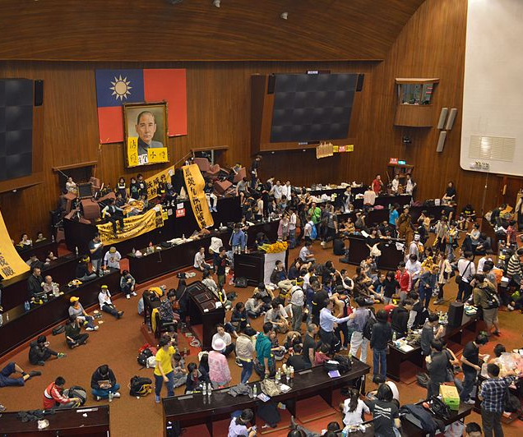
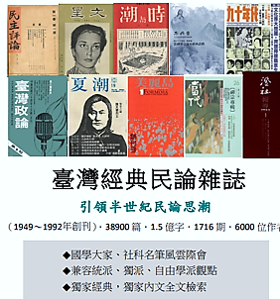
Student Movements Across Generations
The Genes of Taiwan’s Democracy
Taiwan’s democratic DNA — rooted in the magazines preserved here

Slide 34
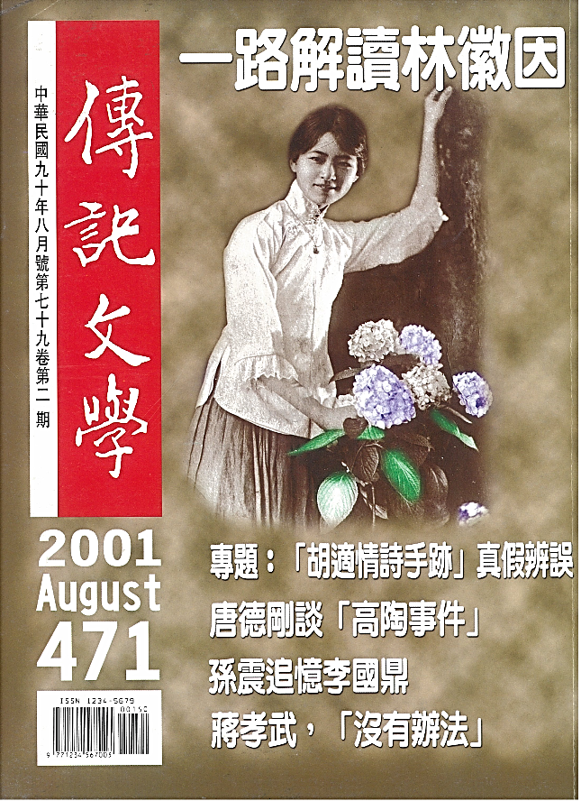
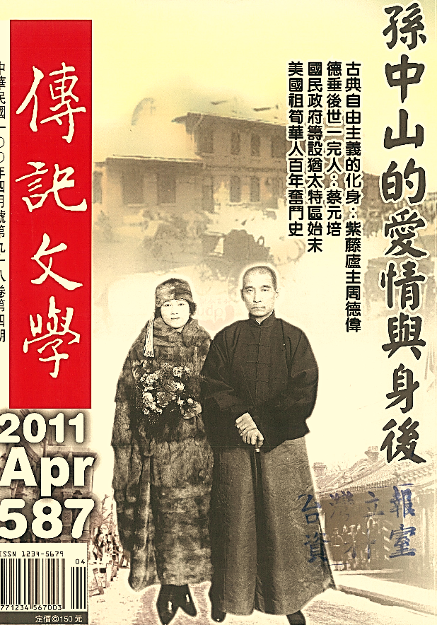
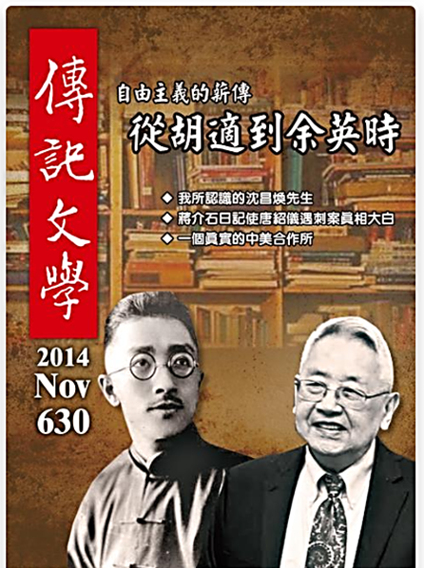
Witnesses to History
Firsthand accounts of modern China’s most remarkable lives:
Generals, officials, spies, elites, gang leaders, performers
Biographies, diaries, memoirs, oral histories, rare documents
，
，
， ，

Slide 35
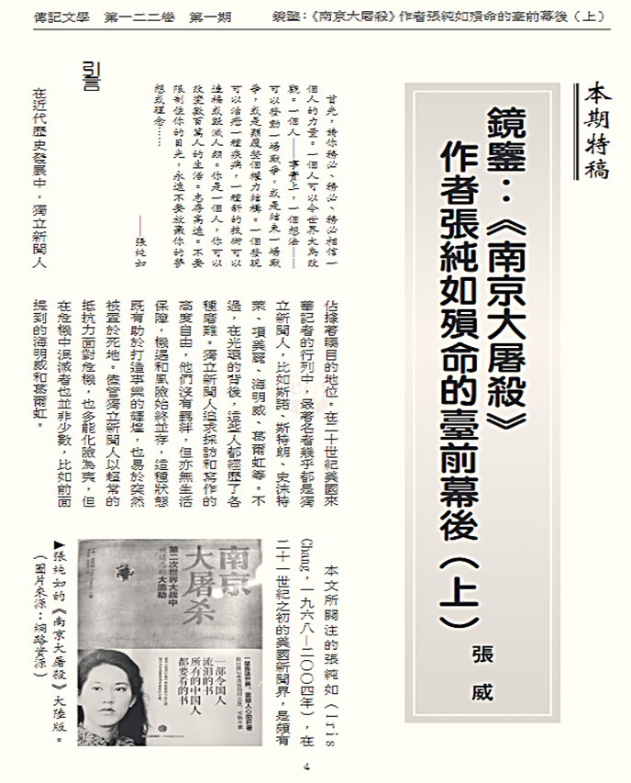
Zhuanji Wenxue Digital Archive
•Since 1962 — 700+ issues, 15,000 articles,
130 million characters
• Complementary to official national
histories, filling key historical gaps
• A cornerstone for Republican China studies
— an exclusive must-have archive
• Complete original layouts with the only
full-text searchable edition

Slide 36
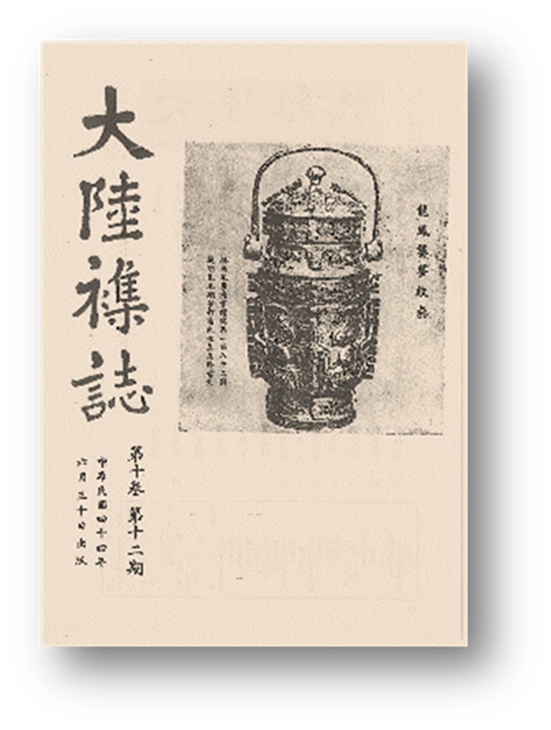
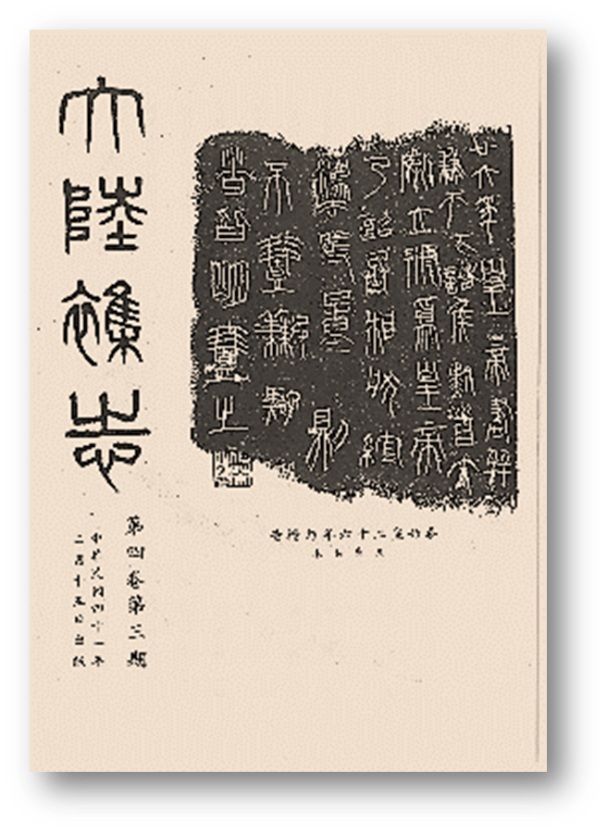
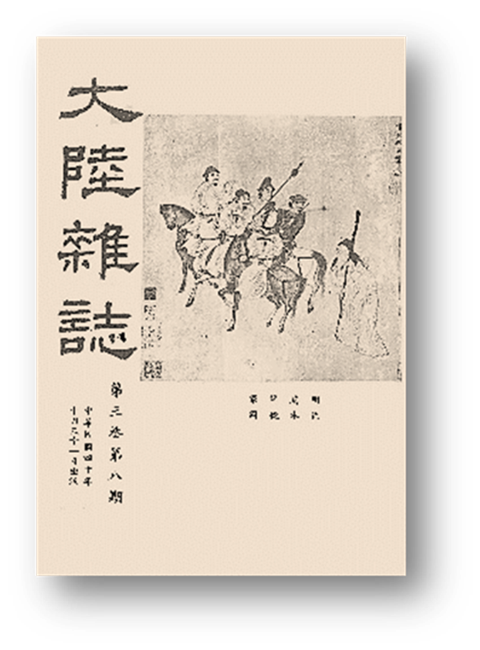
The Continent Magazine
Global Hub of Sinology After 1950
(1950–2002), 7012 articles, 62 million characters, 867 issues, 1400 contributors
•Founded by leading academicians of Academia Sinica
•Tracks modern Chinese thought and key scholarly trends
•Captures 50 years of global Sinology
•Covers humanities and social sciences
•Exclusive archive not available elsewhere

Slide 37
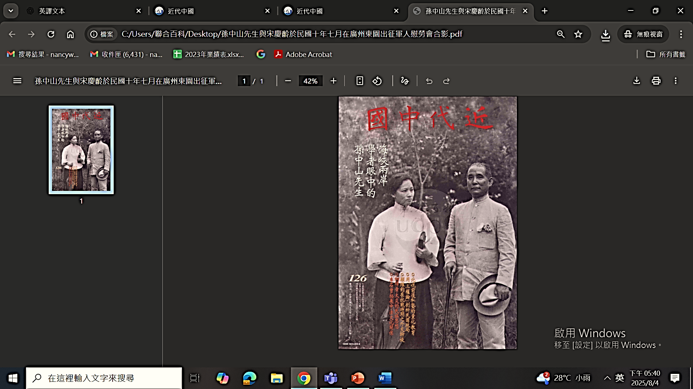
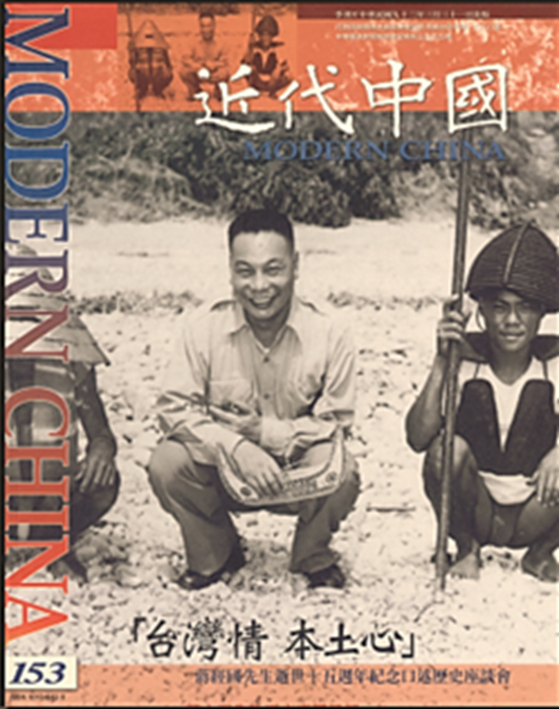
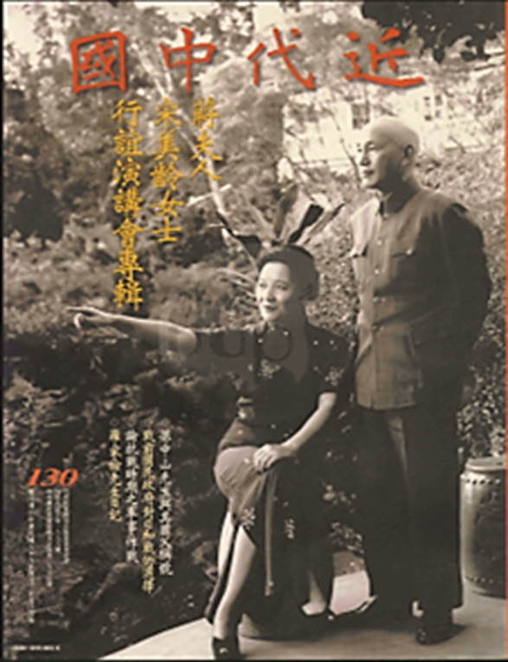
Modern China Digital Archive
Revealing authoritative first-hand KMT historical records
1977–2005, 163 issues, 4902 articles, complete run
•Founded by the KMT Party History Institute
•A century of Republican history, revolutionary
documents, oral histories
•Integrating exclusive archives with historical research
•Manuscripts, diaries, memoirs, biographies, photos,
documents, chronologies, and artifacts of revolutionary
leaders, presidents, and key political-military figures

Slide 38





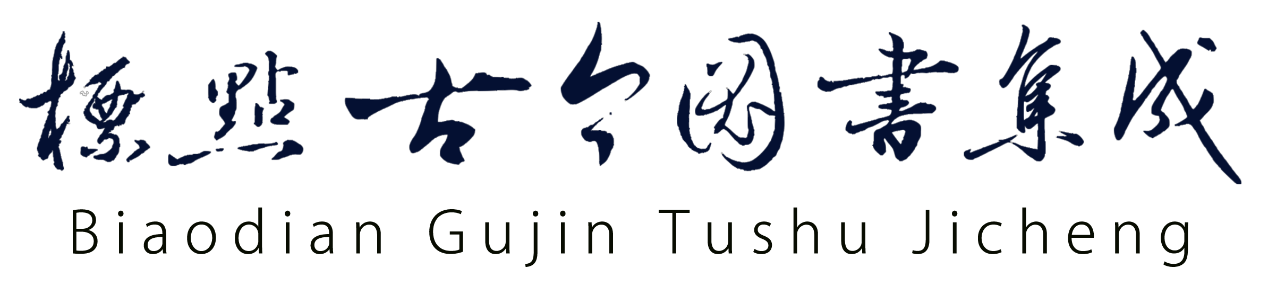
Chinese Classics
With exclusive or unique content from Taiwan, China, and the Chinese-speaking world, this series highlights 5,000 years of Chinese cultural heritage to life through digital innovation.
China Bronze
and Stone Rubbings Collection
人文臺灣
臺灣，擁有五千年中華文化潤澤的人文底蘊，又地處亞太平洋區塊的樞紐位置，早已是「國際漢學」、「當代中國研究」社群中關鍵的一環；臺灣多元社會、海納百川的學術氛圍，更為世界各國探究華人文化與中國社會不可或缺的通路；取道臺灣，就能逕登漢學堂奧。本系列以臺灣最動人的人文學為核心，呈現臺灣學人的開放觀點，以及優秀學術社群的豐美成果。
China Bronze and Stone Rubbings Collection
Notes:
人文台灣

Slide 39


Chinese Calligraphy and Inscription Collection
The most Complete Archive of Renowned Chinese Steles & Calligraphy
4,268 rubbings by 700 calligraphers (Pre-Qin to Qing)
Unicode-based, fully searchable including variant characters
Supports appreciation, teaching, research, and textual analysis
Only database integrating full rubbings, single-character images,
and searchable text

Slide 40







Single Character Database

Slide 41

BiaoDien Gujin Tushu Jicheng
Millennia of Chinese Civilization —AI Connects Past & Present, East & West
Antiquity–Early Qing | 6 Compilations | 32 Canons | 6,117 Sec. | 10,000 Vols. | 140M Characters
• Multilingual Search × Translation — For Non-Chinese Readers
• Classics × Modern Scholarship — Cross-Database Discovery
• First Punctuated Digital Edition — Manually Transcribed & Proofread
• Precise Paragraph-Level Search — Full Text × Original Page Images

Slide 42

China Bronze and Stone Rubbings Collection
World’s Sole Full-Text Digital Archive of Original Rubbings
88,000 exclusive rubbings digitized and globally unveiled for the first time
•118,758 images, 84.94 million characters — over half newly uncovered
• Pre-Qin to 21st century, Rare rubbings from Greater China, Asia, Europe, and the U.S.

Slide 43

The largest and most complete archive of original stone and bronze rubbings across dynasties
Key Difference from Traditional:
Based on first-hand artifacts from excavation
sites and surface finds—not secondary sources.
Features original rubbings with character-by-
character verification and full-text searchability.
Each piece includes: high-quality full rubbing, complete
transcription, and accurate contextual data to ensure
scholarly value.

Slide 44


Taiwan Wenxian Congkan
Taiwan’s Most Comprehensive Historical Archive
•Includes Taiwan gazetteers, Ming-Zheng records,
Qing archives, Southern Ming texts, and literary
anthologies—both official and private works
•A vital resource for local history education and
cultural research studios
•Fast full-text search with Full images
Notes:
Banner視覺更新（跟我要檔案）
.改成、

Slide 45



Taiwan Wenxian Congkan
Unmatched: the sole complete text-image edition of its kind
Notes:
Banner視覺更新（跟我要檔案）
.改成、

Slide 46






Taiwan Wenxian Congkan: Continuation
30,000 Taiwanese poems with full text and full images side by side Documenting Japanese-era Taiwan
Notes:
Banner視覺更新（跟我要檔案）
公牘、檔案的換行用段落去設定（可問我）

Slide 47



228 Incident archival originals / Local Gazetteers
Daxi Archive: Manuscripts by
Chen Yi and Chiang Kai-shek
Confidential telegrams
from Central News Agency
Gazetteer of the Southern Islands (Ryukyu)
Notes:
Banner視覺更新（跟我要檔案）
公牘、檔案的換行用段落去設定（可問我）

Slide 48





Global Think Tank
A global archive of classic think tank intelligence in Chinese, English, Russian, German, Arabic, and more. Features exclusive strategic reports from major powers and rare documents from Eastern Europe, the Middle East, and the Muslim world.
Notes:
人文台灣

Slide 49







Global Press Archive
Cambridge Digital Archive
Manhua Digital Archive

Slide 50







Countries, Regions and Global Governance
Belt and Road Initiative Database
Chinese Academic Journals
and Anthologies Database
Pishu Database

Slide 51






International Activities
Dedicated to the convergence of Sinology and Western thought, revealing the beauty of cross-cultural exchange
International Exhibition
Conference
Industry–Government–Academia Collaboration
Notes:
國際參展｜漢學研討｜產官學合作

Slide 52

In-person and online salons
featuring scholars and librarians from diverse countries and cultures, sparking cross-cultural dialogue on trending topics.

Slide 53


Industry–Government–Academia
Collaboration
UDP regularly visits renowned libraries, institutions, and librarians worldwide, actively partnering with leading scholars to promote multicultural researches.

Slide 54



Our Partners
Renowned digital vendors advancing HSS worldwide

Slide 55



























Representative Clients in North America

Slide 56


























Representative Clients in Asia/Oceania

Slide 57






























Representative Clients in Europe
1,200+ global subscribers: top Sinology libraries & elite universities

Slide 58

Contact Us
Thank you for listening!
4F-7, No. 70, Sec. 2, Nan Chang Rd., Zhong Zheng Dist. Taipei City, TAIWAN (R.O.C.)
PHONE
EMAIL
WEBSITE
02-23655908
udp.webaa@gmail.com
www.udpweb.com

